Slide 1

ECEN 3593-001 Computer Organization
Lecture #15
22 February 2021

Slide 2


Agenda
Class Announcements
Phase 5
Chapter 4 – Pipelining

Slide 3
Class Announcements
Reading for the week
“Computer Organization and Design, The Hardware / Software Interface, RISC-V edition,” by David Patterson and John Hennessy
ISBN 978-0-12-812275-4
Chapter 4, “The Processor”
pages 236-314 (sections 4.1 thru 4.8)
Homework #2 correct answers enabled in Canvas

Slide 4
Class Announcements
A useful tool has been posted under “Instruction Translator” in Canvas
This is an Excel-based disassembler which translates Machine code to Assembly code
Handy for understanding the Assembly <-> Machine function
Includes a User’s Guide

Slide 5
Class Announcements
Phase 3 is in the deduction period – 20% + 5%/day
Phase 4 is in the deduction period – 4%/day
If you have successfully completed Phase 4 your scores are posted in Canvas
Phase 5 Target Date is Sunday, February 28 at 10:00 PM
Homework #3 will be posted next week
My OH MWF 2:00 to 3:00. This week I will have an open Zoom meeting each day at https://cuboulder.zoom.us/j/4317981384
Also can request meeting any time

Slide 6
Phase 5 Process
Update each of the files in the ca area
Use the Phase 4 schematics!
Get this to build (Simulator (ca))
Edit files until it does
Run phase5_test on CA Simulator
Debug
Repeat until success and submit
Debug is likely to take quite a while – don’t wait

Slide 7
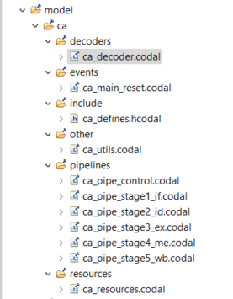
Codasip CA Model
Decode the instruction to create all control signals
Main processing loop
Defines the various control enums and bit field widths
Debug utilities
Stall/flush functions
Actual pipeline processes
Register and signal definitions

Slide 8
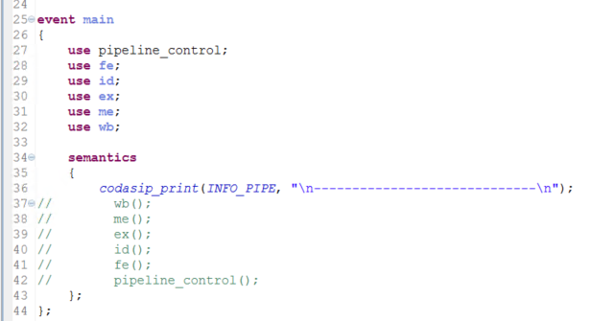
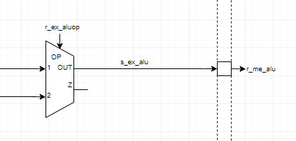
Codasip Operation
Starts with “main” function in ca_main_reset.codal
Calls each pipeline function in order and executes its code
Then ALL registers are updated with their new input values SIMULTANEOUSLY
One clock cycle has now been executed
Loop back and repeat until HALT
Why are the stages in reverse?

Slide 9
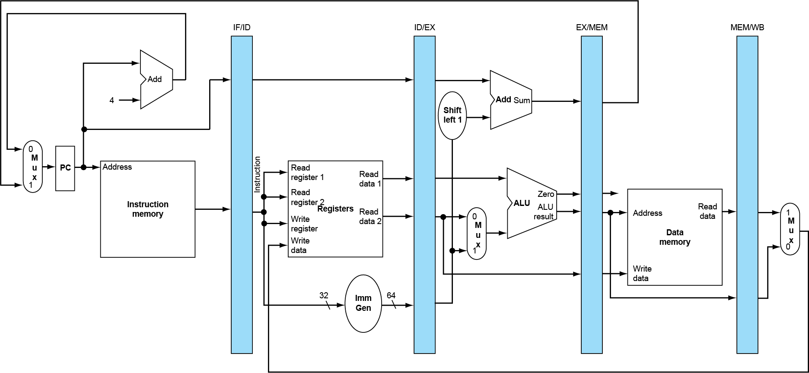
Evaluating Right to Left
Normal data flows left to right (IF -> WB) through the pipeline registers
But some data is required by a later (i.e. to the left) cycle
Thus the rightmost value (e.g. WB) must be computed first

Slide 10
Phase 5
Questions?

Slide 11
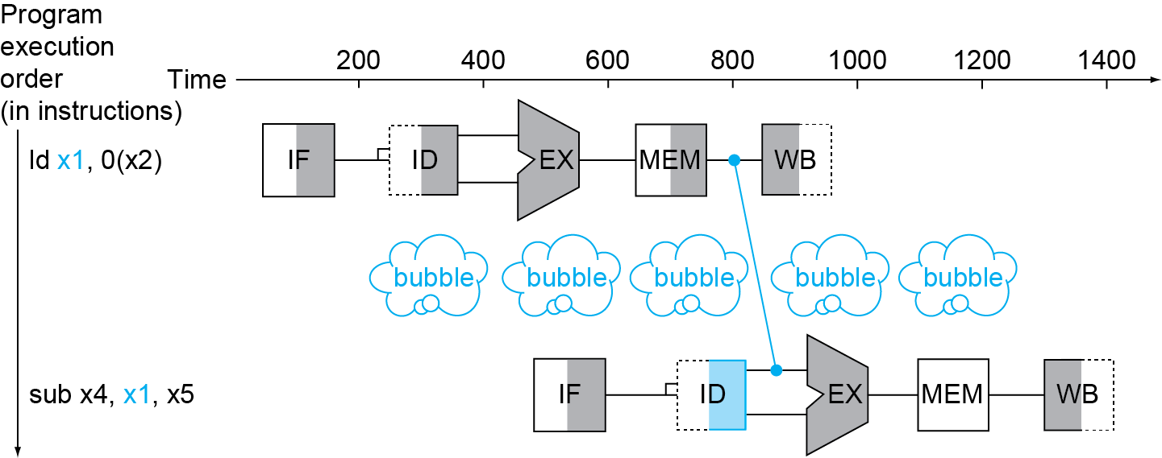
Load Use Data Hazard
Can’t always avoid stalls by forwarding
If value not computed when needed
Can’t forward backward in time!
The pipeline must stall for 1 cycle

Slide 12
The compiler comes to the rescue – at least sometimes
Reorder code to avoid use of load result in the next instruction
C code for A = B + E; C = B + F;
ld x1, 0(x0)
ld x2, 8(x0)
add x3, x1, x2
sd x3, 24(x0)
ld x4, 16(x0)
add x5, x1, x4
sd x5, 32(x0)
ld x1, 0(x0)
ld x2, 8(x0)
ld x4, 16(x0)
add x3, x1, x2
sd x3, 24(x0)
add x5, x1, x4
sd x5, 32(x0)
stall
stall
9 cycles
7 cycles

Slide 13
Control Hazards
Control hazards arise from the need to make a decision based on the results of one instruction that affect instructions already in the pipeline
Branch determines flow of control
Fetching next instruction depends on branch outcome
Pipeline can’t always fetch correct instruction
In RISC-V pipeline
Need to compare registers and compute target early in the pipeline
Could add hardware to do it in ID stage (only realistic for BEQ/BNE)
But – we will not do this in our design

Slide 14
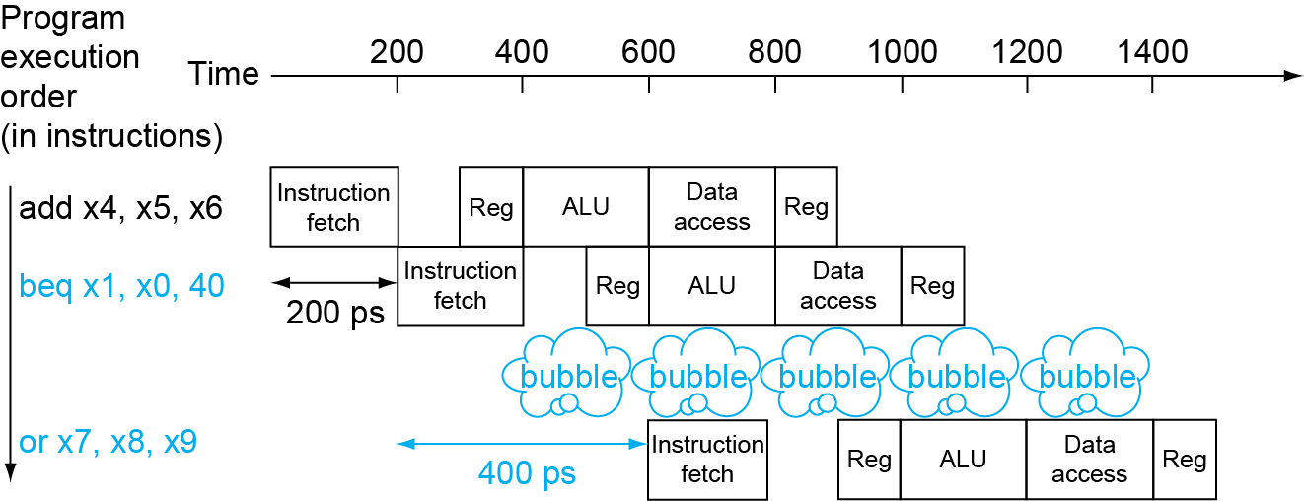
The CPU could stall a cycle to determine what address to fetch after the branch?
Wait until branch outcome determined before fetching next instruction
This would effectively make all branch instructions a CPI of 2

Slide 15
MIPS Solution – Branch Delay Slot
The MIPS architecture implements a Branch Delay Slot
beq x1, x2, -40
add x5, x6, x7 <- this instruction is always
executed, even if the branch is
taken
If the assembler can’t find an instruction that works here, a NOP must be inserted

Slide 16
Predict the next address after the branch
Branch prediction is a method of resolving a branch hazard that assumes a given outcome from the branch and proceeds from that assumption rather than waiting to be certain the actual outcome
Longer pipelines can’t readily determine branch outcome early
Stall penalty becomes unacceptable
Predict outcome of branch
Only stall if prediction is wrong
In RISC-V pipeline
Can predict branches not taken
Fetch instruction after branch, with no delay

Slide 17
Predict Not Taken
Predict not taken
20: add x1, x2, x3
IF
ID
EX
ME
WB
But actually taken
24: beq x4, x5, 60
IF
ID
EX
ME
WB
So FLUSH 3 instructions
X
X
X
28: and x7, x8, x9
IF
ID
EX
X
X
32: slt x8, x7, x10
IF
ID
X
36: add x12, x13, x20
IF
60: xori x14, x13, 0xFF
IF

Slide 18
Why Do We Have to Flush 3 Instructions?
The ZERO output from the ALU, which is used to make the branch selection, is available at the end of the EX stage
It is then pipelined, so the branch decision is made in the ME stage
This means that we load the PC with the target address in the following stage, which is 3 cycles later

